Slide 1


R Markdown
Lewis Mews

Slide 2
Intro
All the material with scripts/examples can be downloaded from my GitHub directory:
https://github.com/Lewismews/Colchester_User_Meetup
Lewis.Mews@objectiveit.com

Slide 3
Intro
What is R markdown
Use cases
Go through a script
Different Output types
Supported Languages
Summary

Slide 4
What is R Markdown?
HTML in an easy to read format.
Predominantly used to produce HTML, PDFs and Word docs
Core syntax of markdown with embedded R chunks to create dynamic documents.

Slide 5
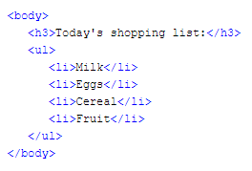
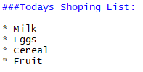
HTML Vs R Markdown

Slide 6
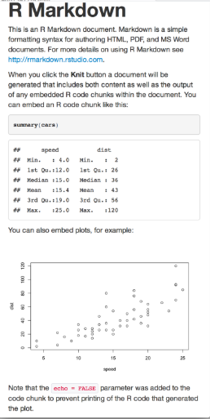

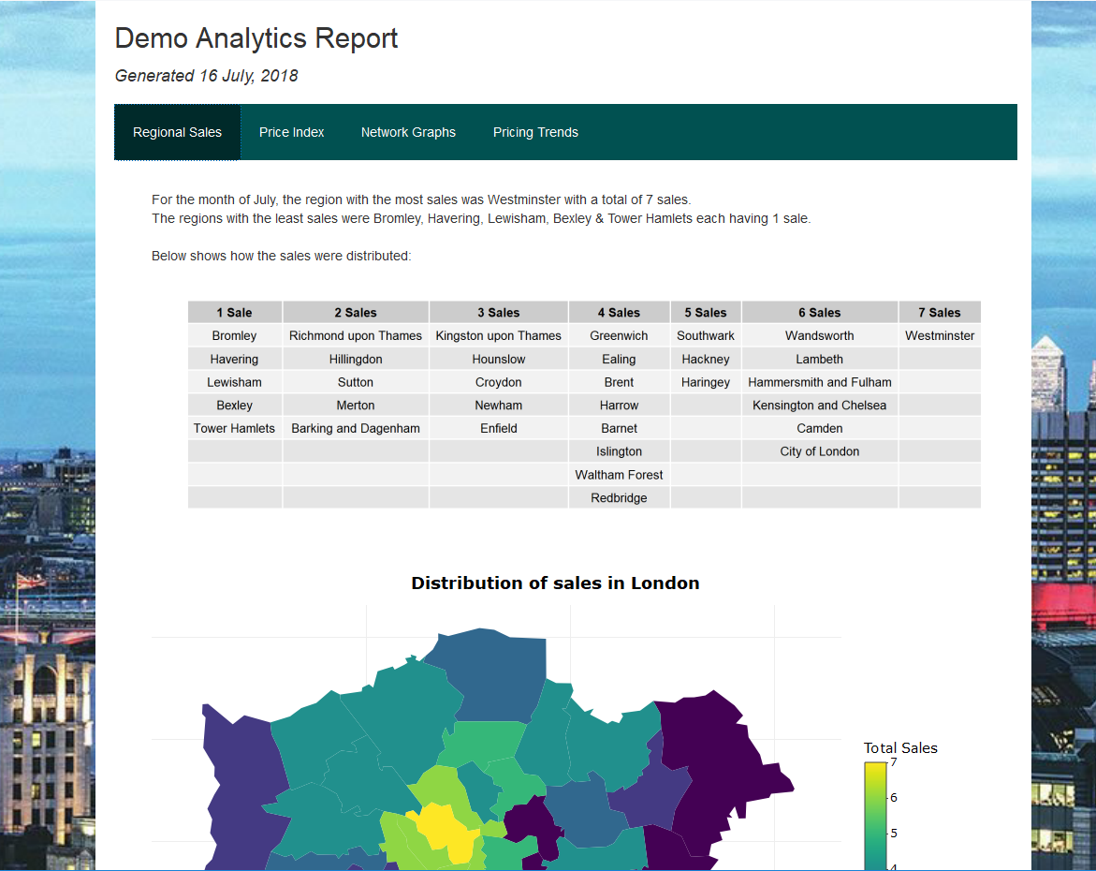

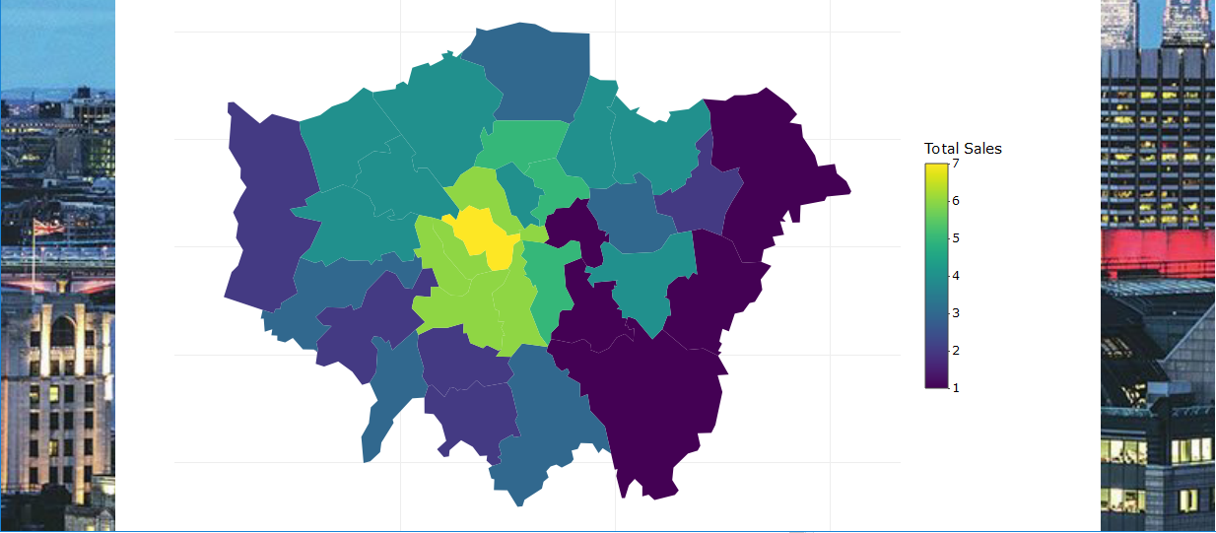
What is R Markdown used for
Papers/Assignments
Automation of reports
Notes:
<center> <h1>heading 1</h1> </center> indents the title

Slide 7
YAML header
This is where you input the structure of your file.
Title
Author
Date
Type of output
CSS/Theme
Notes:
Yet Another Markup Language now stands for YAML Ain't Markup Language

Slide 8
Text
Code | Result
#Header | Produces a Header (up to #######)
__abc__ or **abc** | Bold
_abc_ or _abc_ | Italics
* | Bullet Point
1) | Numbered list
[Link Name] (link URL) | Hyperlink
![alt text](path/image) | Image
Enter a double space | Creates new paragraph
`r 2+2` | You can run R code without the need for a chunk. This will produce 4

Slide 9
Code Chunk
Code chunk has 3 parts
‘’’ ```
{}
Code

Slide 10
Chunk Options
Code | Result
Echo | Whether to display code along with the results
Warning | Whether to display Warnings along with the results
Error | Whether to display Errors along with the results
Highlight | Whether to highlight your code (If Echo=TRUE)
Fig.Width | Width of your plot, in inches
Fig.Height | Height of your plot, in inches
Eval | Whether to Evaluate your code and include its results
Cache | Whether to Cache your results for future use

Slide 11
What formats are supported
Slidy
Ioslides
Html
Notebook
Pdf
rtf
Word
Latex
Dashboard
Tufte handout
Shiny
Beamer

Slide 12
What languages are supported
Scala
Rcpp
C
R
Ruby
SQL
Python
Bash

Slide 13
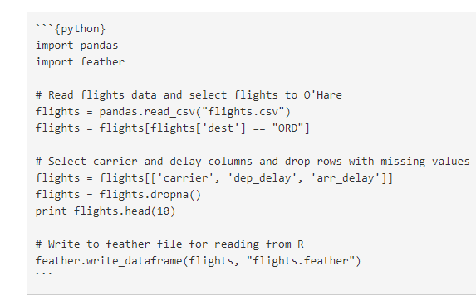
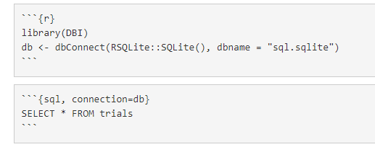
Python and SQL Script

Slide 14
To Note
You will need to install
rmarkdown
knitr
something to read pdf E.g. Miktex

Slide 15
Useful Links
https://www.rstudio.com/wp-content/uploads/2015/03/rmarkdown-reference.pdf
https://www.rstudio.com/wp-content/uploads/2015/02/rmarkdown-cheatsheet.pdf
https://blog.rstudio.com/2018/03/26/reticulate-r-interface-to-python/

Slide 16
Summary
Great for Automated Reports or if you want to combine text with your R code
Main sections: YAML header, inline text and Code chunks
Supports many different outputs/languages

